Slide 1
Metagenome binning: A case study
Emiley Eloe-Fadrosh, PhD
MGM-23

Slide 2
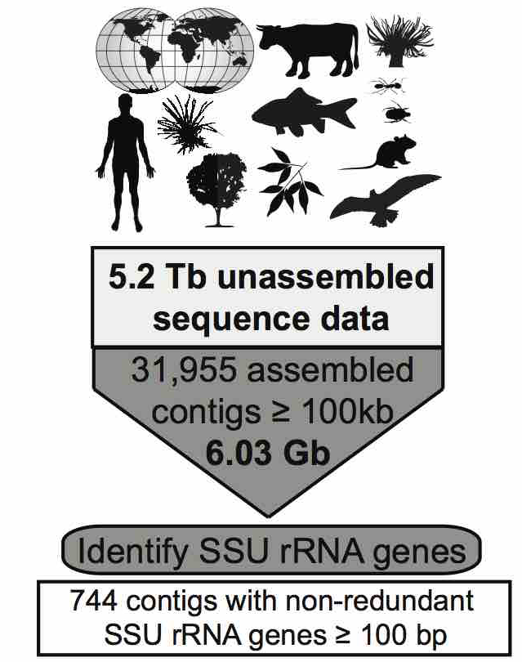
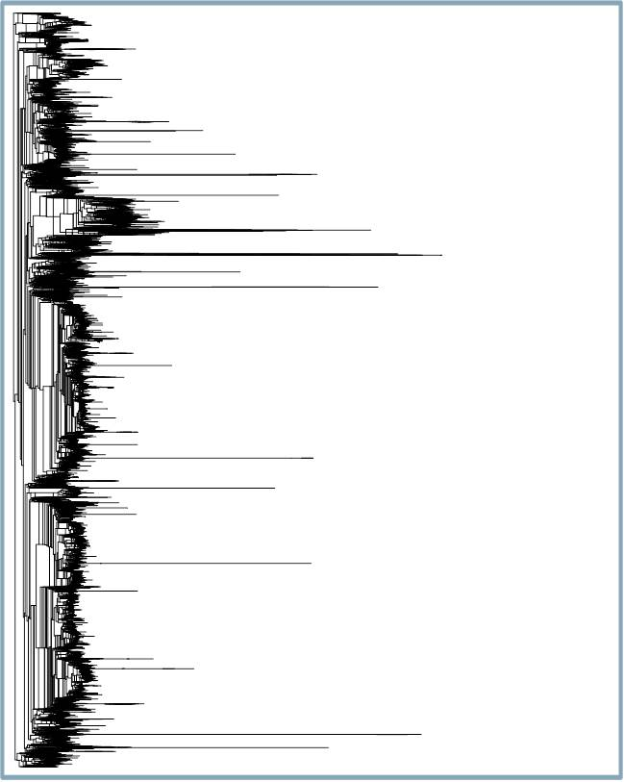
Large-scale data mining to identify novel microbial lineages
16S rRNA Tree with 744 Sequences

Slide 3
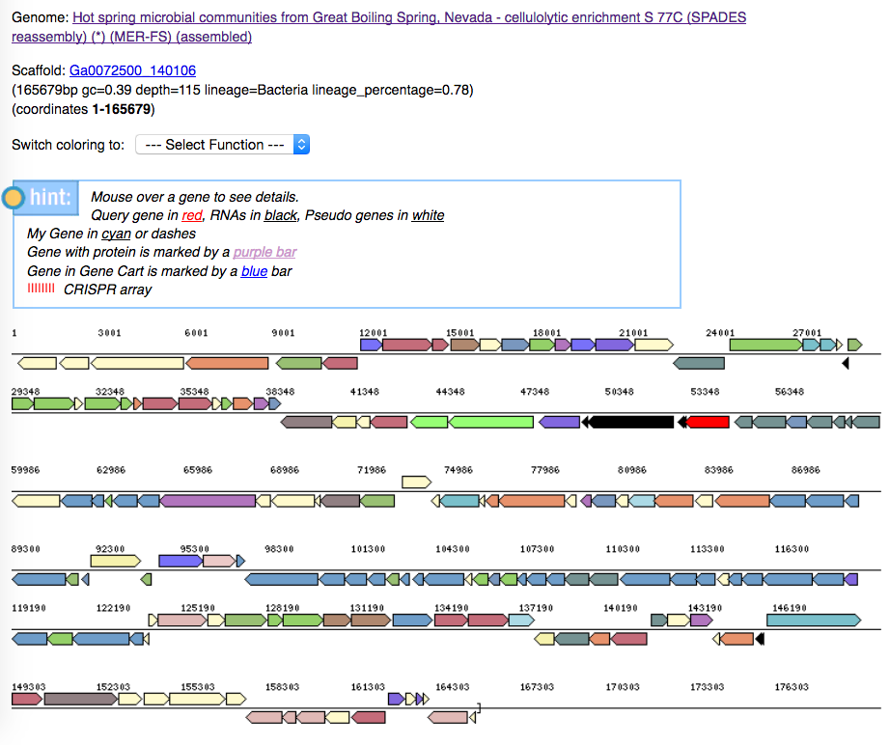
Large-scale data mining to identify novel microbial lineages
16S rRNA gene with low similarity to other 16S sequences in the database

Slide 4
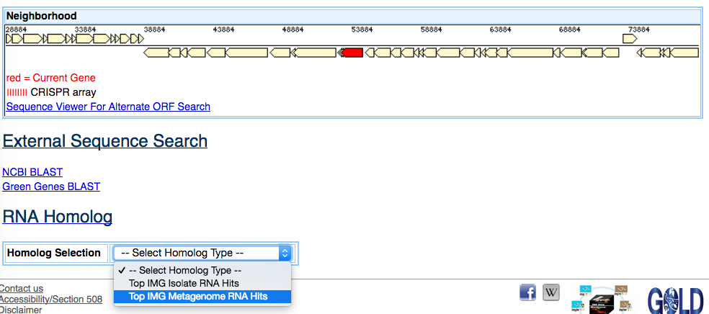
Large-scale data mining to identify novel microbial lineages
Identify whether other similar 16S rRNA gene sequences could be found in IMG

Slide 5
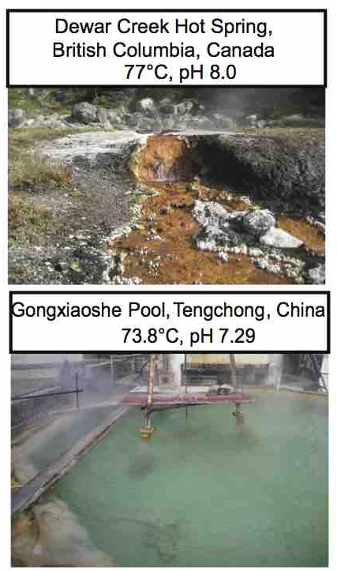
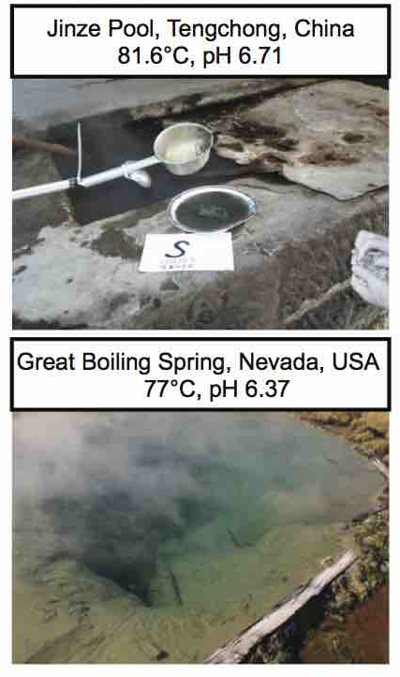
Large-scale data mining to identify novel microbial lineages
Identified four metagenomes containing contigs with similar 16S rRNA gene

Slide 6
Candidate phylum missed in 16S surveys
Candidatus Kryptonia
from the Greek word ‘krupton,’ hidden or secret

Slide 7
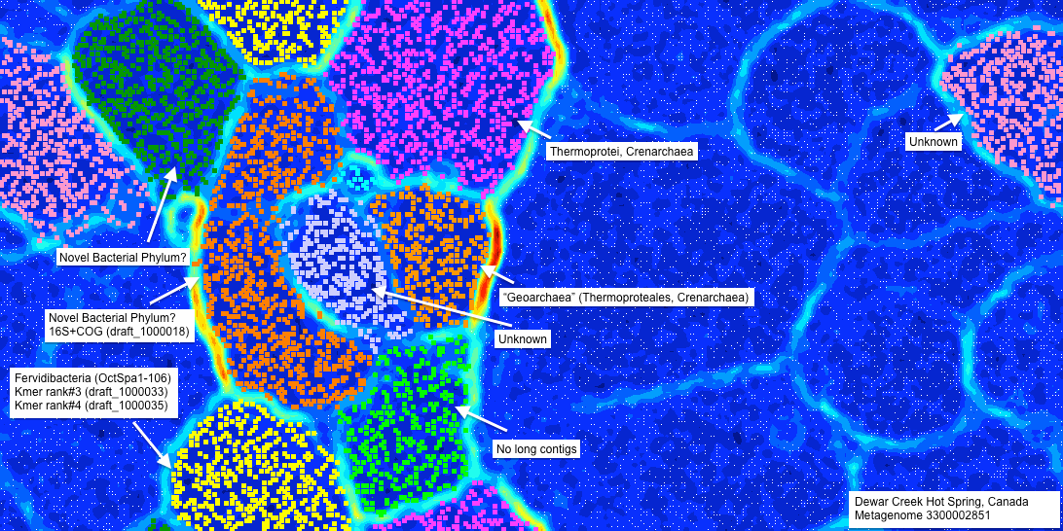
Metagenome binning
Identify bin of interest based on contig containing 16S

Slide 8
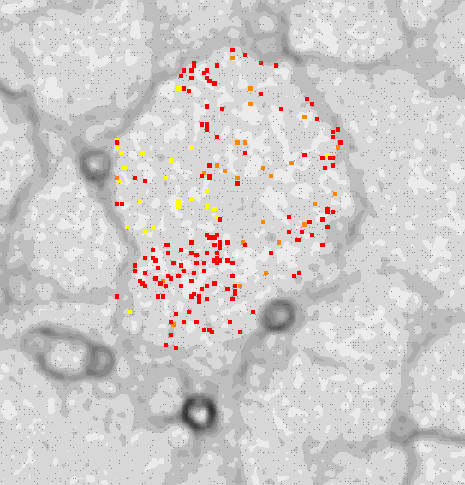
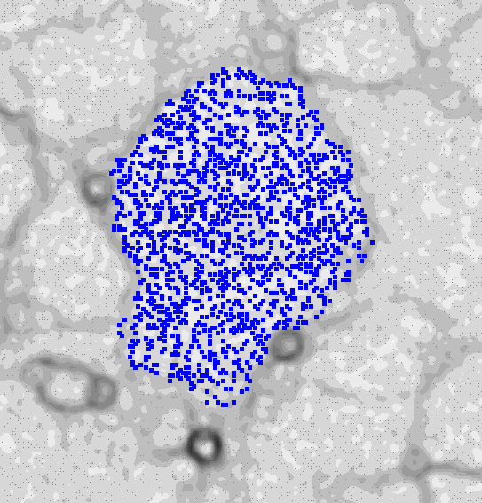
Metagenome binning
Binning of all metagenomes together to help identify four genomes from new candidate phylum

Slide 9
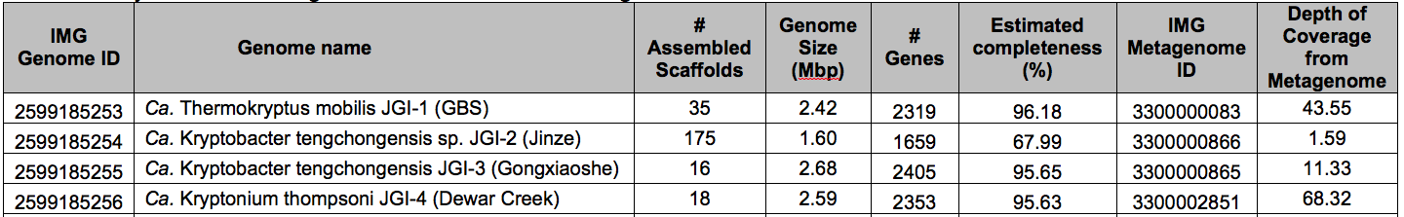
Metagenome binning
Recovered four genomes from metagenomes (GFMs)
Three genomes > 95%
estimated genome completeness
High coverage from metagenomes

Slide 10
A new member of the FCB superphylum
Fibrobacter-Chlorobi-Bacteroidetes (FCB) Superphylum

Slide 11
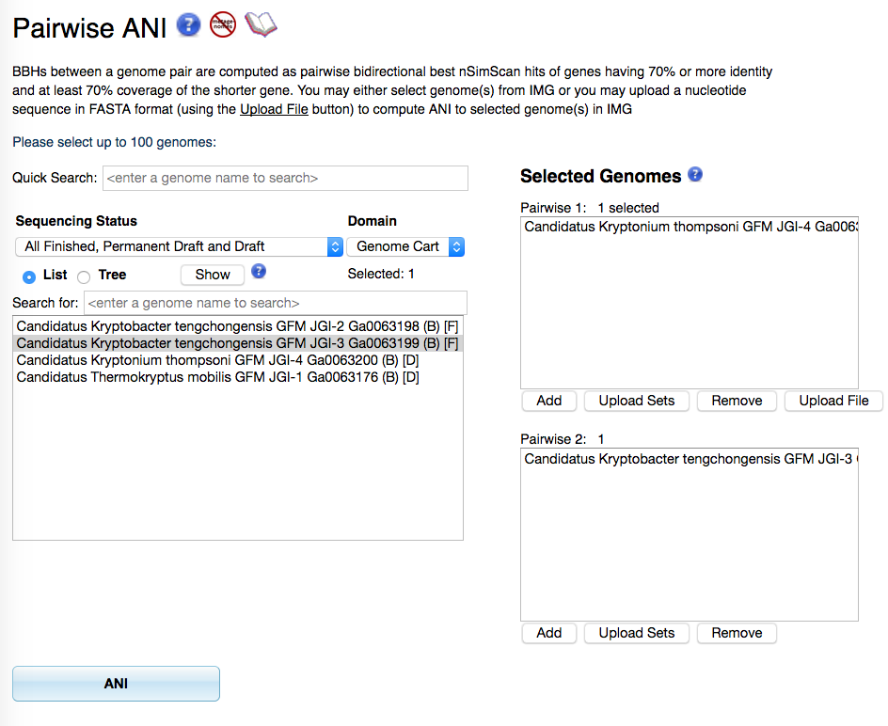
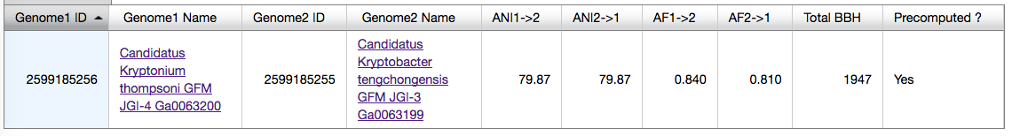
How similar are the four GFMs?

Slide 12
How similar are the four GFMs?
A closer look at the four Kryptonia genomes suggests these represent different species, and likely different genera

Slide 13
Recovery of 18 single-cell genomes

Slide 14
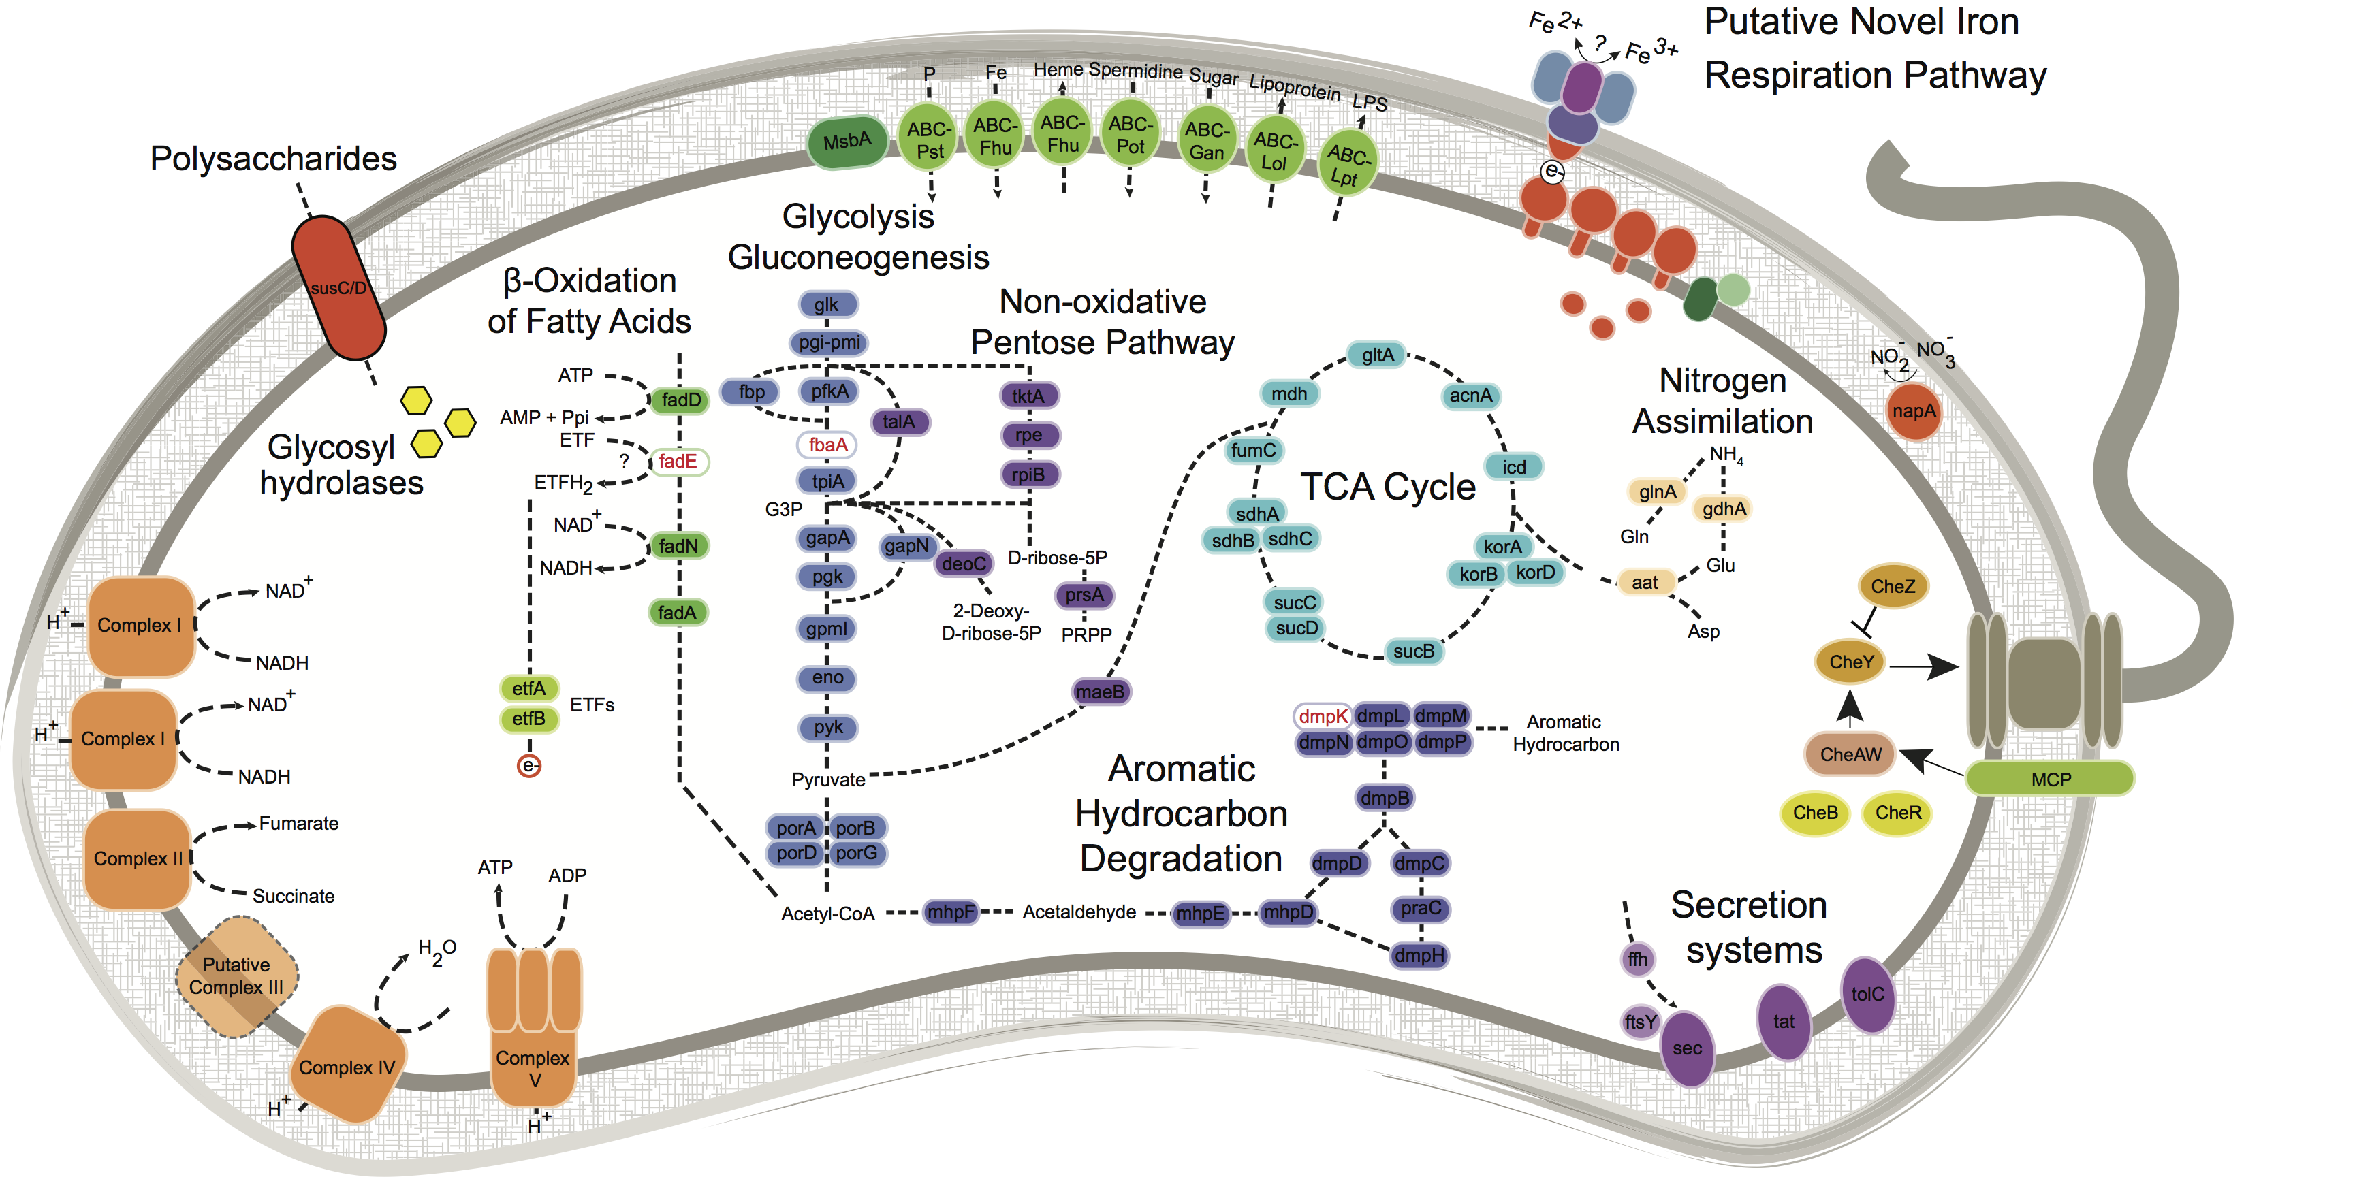
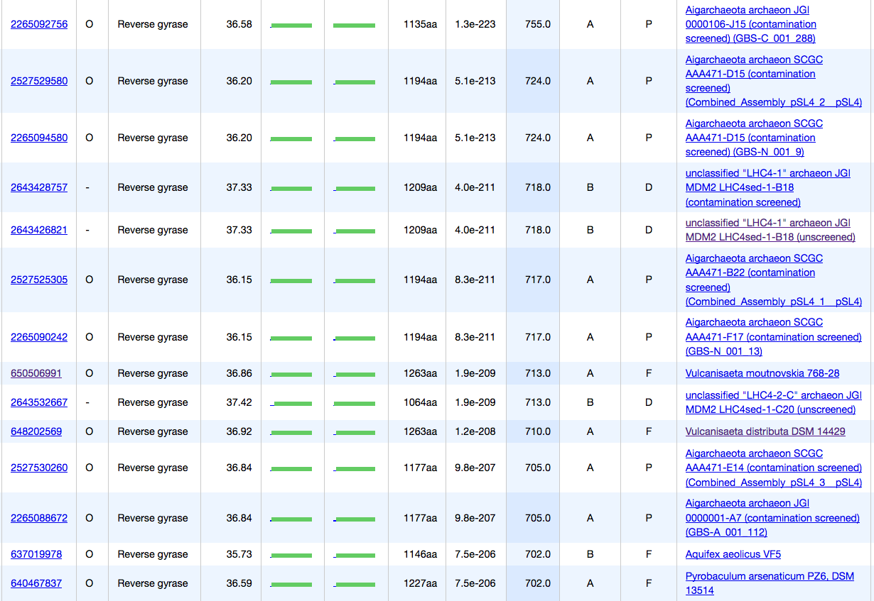
A glimpse of Kryptonia’s unique features
Closest matches to archaeal reverse gyrase
Archaeal-like reverse gyrase
Bacteria
Kryptonia
Archaea
Notes:
Kryptonia is a metabolically versatile, motile heterotroph with a complete TCA cycle and key enzymes for glycolysis and the pentose phosphate pathway.
Evidence for hyperthermophlic adaptation with reverse gyrase, but curiously this seems to be horizontally transferred from a crenarcheaota.
We found an elaborate and unique respiratory pathway for the redox transformation of iron that was similar, yet non-homologous to the well-characterized pathway in Shewanella oneidensis. We hypothesize that Kryptonia might impact metal biogeochemistry in these geothermal spring, and might even compete with archaeal community members.
Kryptonia also have the potential for aromatic hydrocarbon degradation via oxidation to catechol, and subsequent meta-cleavage. We identified another seemingly horizontally transferred gene from the archeaeon Ferroglobus for anaerobic aromatic compound degradation. This feature appears to be the first example of a hyperthermophilic bacterium with the capacity to oxidize aromatic compounds, and holds biotechnological potential as well as implications for carbon cycling within these spring environments.
The genomes also lacked most amino acid biosynthetic machinery, including the evolutionarily ancient histidine pathway. Same with components for thiamin and biotin biosynthesis. We hypothesize that Kryptonia might engage in a microbial partnership to supplement many of the essential amino acids and vitamin requirements.

Slide 15
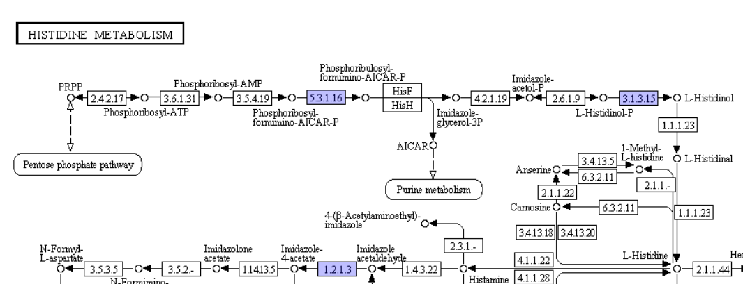
A glimpse of Kryptonia’s unique features
Missing most AA biosynthetic machinery
hisF
hisH
Notes:
Kryptonia is a metabolically versatile, motile heterotroph with a complete TCA cycle and key enzymes for glycolysis and the pentose phosphate pathway.
Evidence for hyperthermophlic adaptation with reverse gyrase, but curiously this seems to be horizontally transferred from a crenarcheaota.
We found an elaborate and unique respiratory pathway for the redox transformation of iron that was similar, yet non-homologous to the well-characterized pathway in Shewanella oneidensis. We hypothesize that Kryptonia might impact metal biogeochemistry in these geothermal spring, and might even compete with archaeal community members.
Kryptonia also have the potential for aromatic hydrocarbon degradation via oxidation to catechol, and subsequent meta-cleavage. We identified another seemingly horizontally transferred gene from the archeaeon Ferroglobus for anaerobic aromatic compound degradation. This feature appears to be the first example of a hyperthermophilic bacterium with the capacity to oxidize aromatic compounds, and holds biotechnological potential as well as implications for carbon cycling within these spring environments.
The genomes also lacked most amino acid biosynthetic machinery, including the evolutionarily ancient histidine pathway. Same with components for thiamin and biotin biosynthesis. We hypothesize that Kryptonia might engage in a microbial partnership to supplement many of the essential amino acids and vitamin requirements.

Slide 16
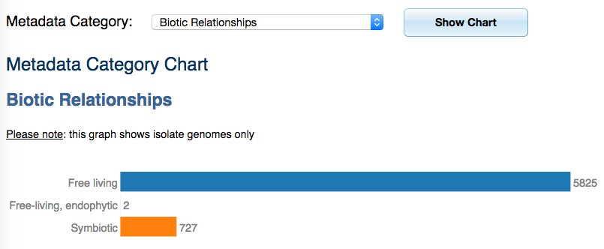
Other genomes missing AA machinery?
Identify FCB superphylum genomes with lifestyle metadata

Slide 17
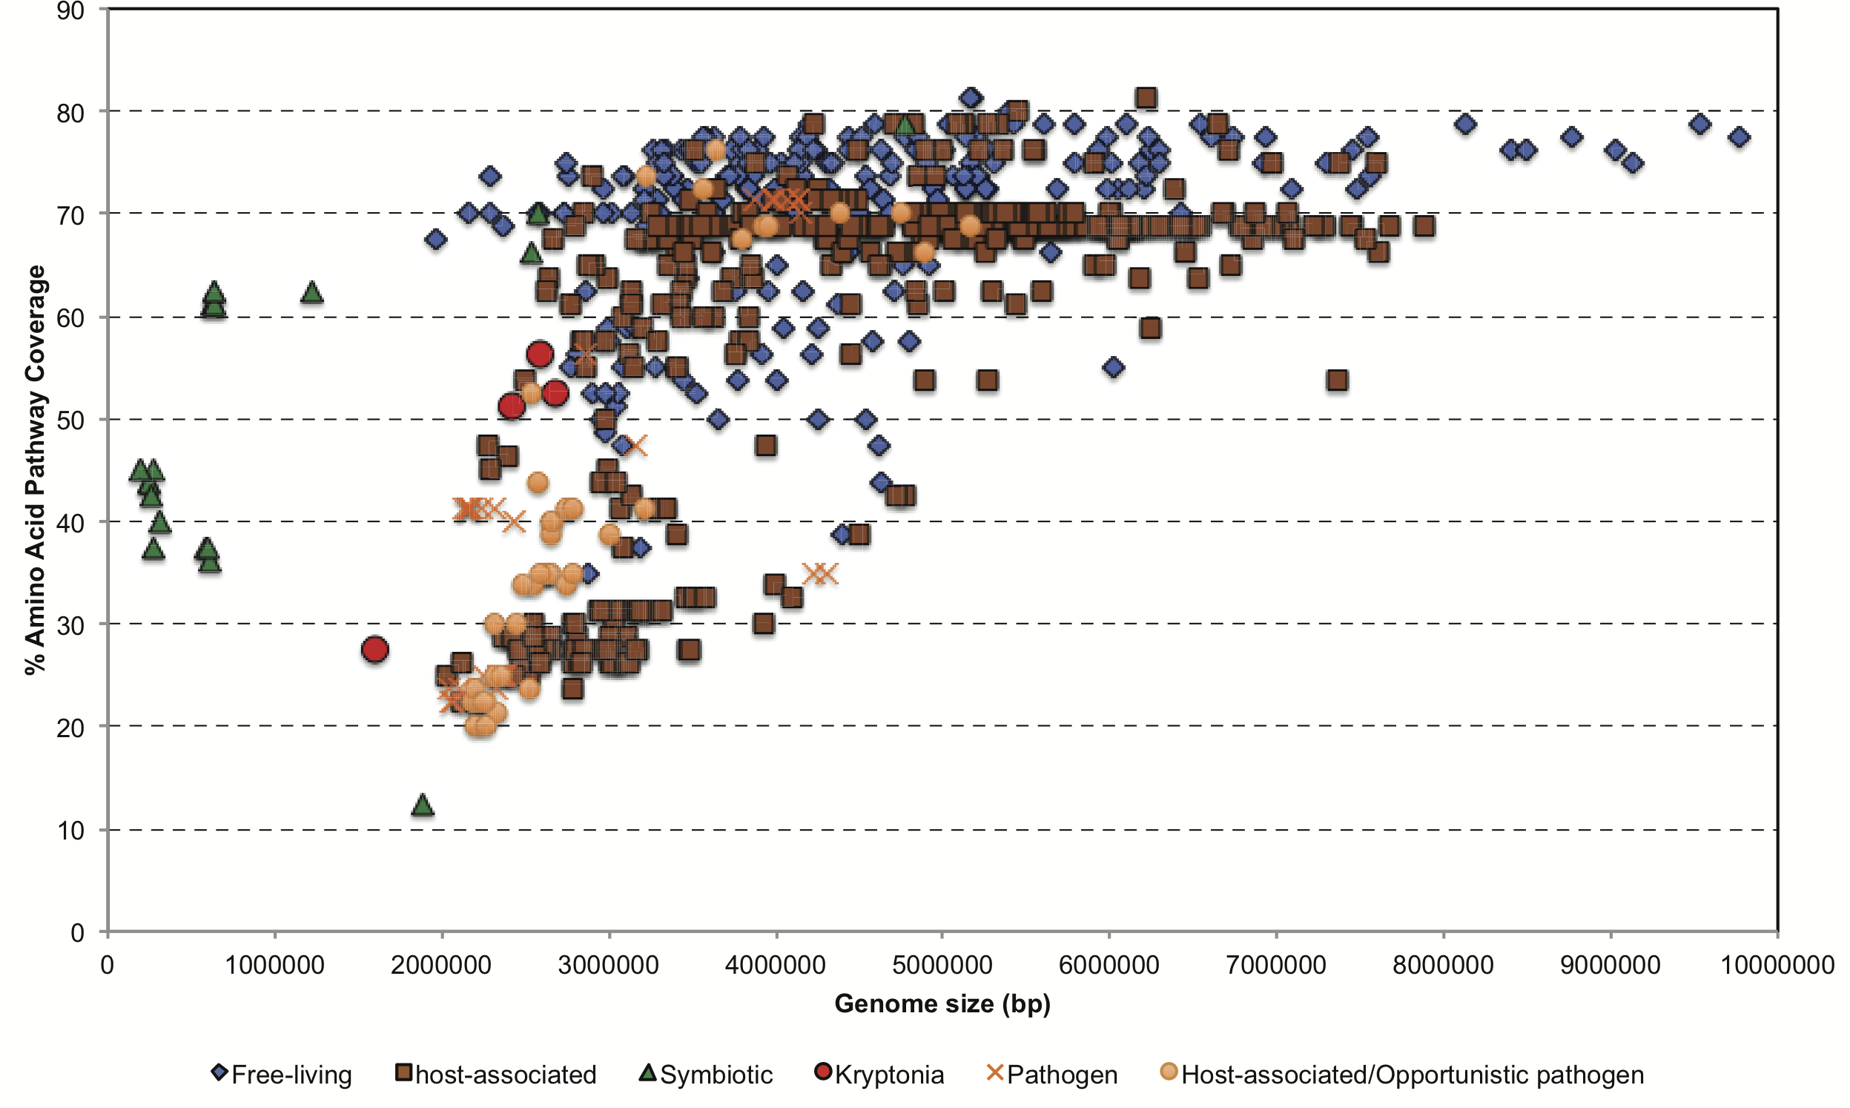
Other genomes missing AA machinery?
759 FCB genomes with lifestyles: free-living, host-associated, pathogen and obligate symbiont
Hypothesize Kryptonia engages in partnership(s) to complement metabolic deficiencies

Slide 18
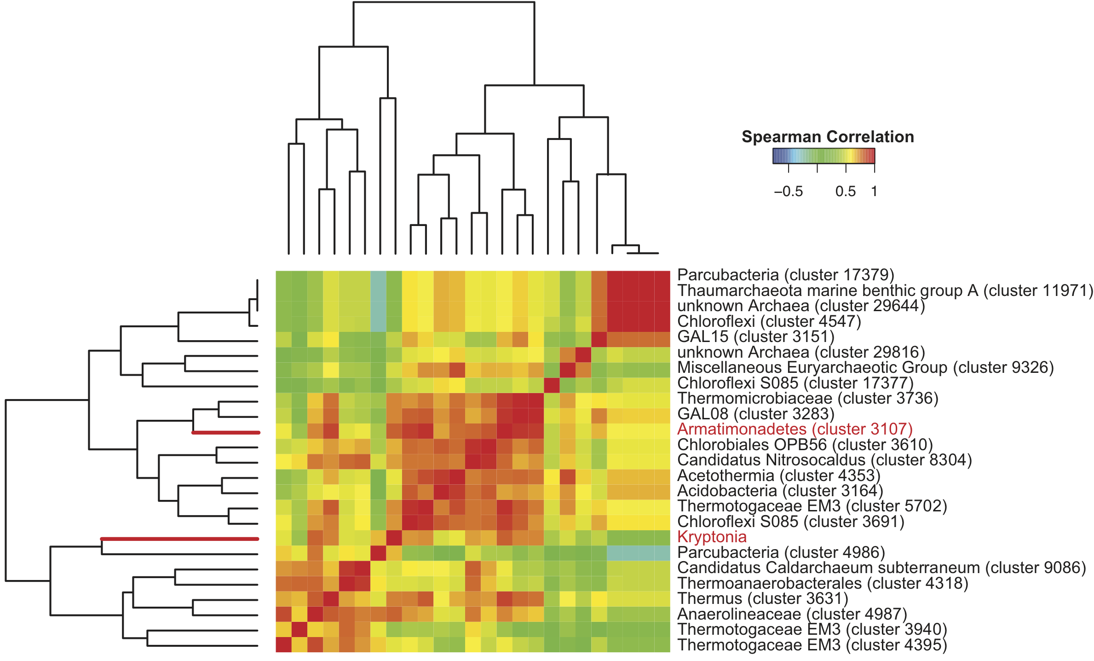
Search for potential microbial partner(s)
Correlation analysis of 16S rRNA abundance patterns

Slide 19
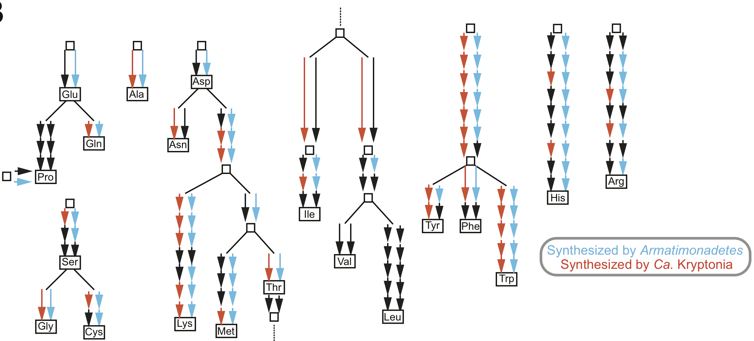
Search for potential microbial partner(s)
Recovered three genomes from metagenomes (GFMs) for the Armatimonadetes
Coverage consistent with Kryptonia GFM coverage

Slide 20
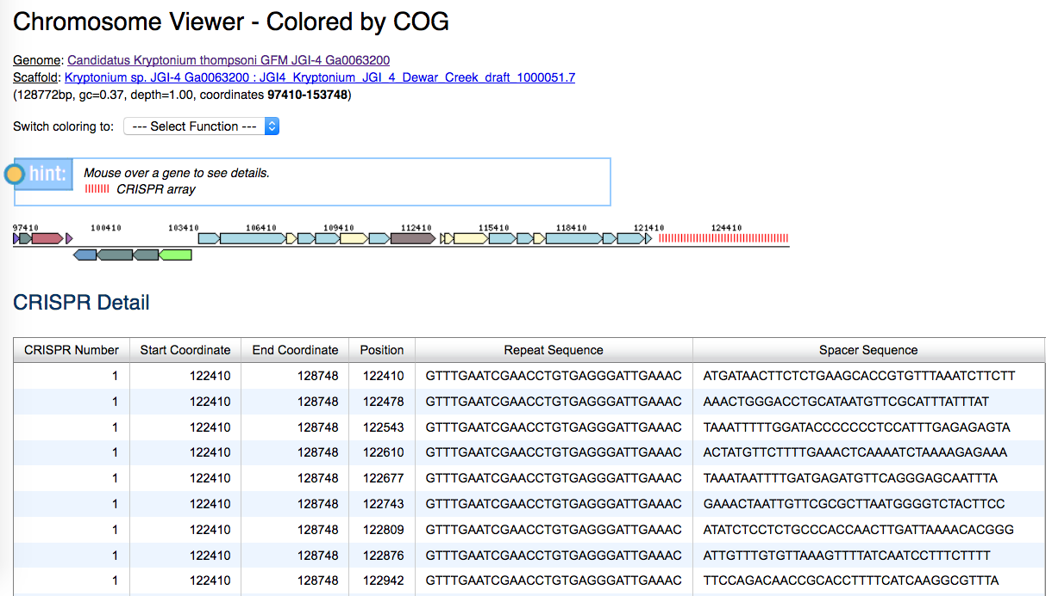
Evidence for defense against viruses
Identification of CRISPR-Cas system

Slide 21
Evidence for defense against viruses
Novel hybrid CRISPR-Cas system

Slide 22
Summary
Discovery of a new candidate phylum in hot springs
ESOM binning to recover genomes from metagenome data
Compared how similar genomes are using ANI
Detailed metabolic and functional properties with a variety of tools in IMG

Slide 23

Acknowledgements
Brian Hedlund
Hailiang Dong
Brandon R. Briggs
Wen-Jun Li
Eddy Rubin
Natalia Ivanova
Nikos Kyrpides
Amrita Pati
David Paez
Tanja Woyke
Rex Malmstrom
Jessica Jarett
Danielle Goudeau
Peter F. Dunfield
Stephen E. Grasby
Allyson L. Brady
Ilona Ruhl
IMG and Genomes OnLine Database teams
DOE JGI production sequencing team
Support under Contract No. DE-AC02-05CH11231 and resources of the National Energy Research Scientific Computing Center.
Eloe-Fadrosh, E. A., D. Paez-Espino, J. Jarett, P. F. Dunfield, B. P. Hedlund, A. E. Dekas, S. E. Grasby, A. L. Brady, H. Dong, B. R. Briggs, W.-J. Li, D. Goudeau, R. Malmstrom, A. Pati, J. Pett-Ridge, E. M. Rubin, T. Woyke, N. C. Kyrpides and N. N. Ivanova (2016). Global metagenomic survey reveals a new bacterial candidate phylum in geothermal springs. Nature Communications 7: 10476. doi:10.1038/ncomms10476

